Slide 1
Shi-Tomasi corner detector
Marek Berta, Filip Burda, Jakub Geľo

Slide 2






Overview
$$eig\left(M\right)=λ_{1},λ_{2}$$
Harris Detector
Shi-Tomasi Detector
$$R=λ_{1}λ_{2}−κ{\left(λ_{1}+λ_{2}\right)}^{2}$$
$$R=min⁡(λ_{1},λ_{2})$$

Slide 3
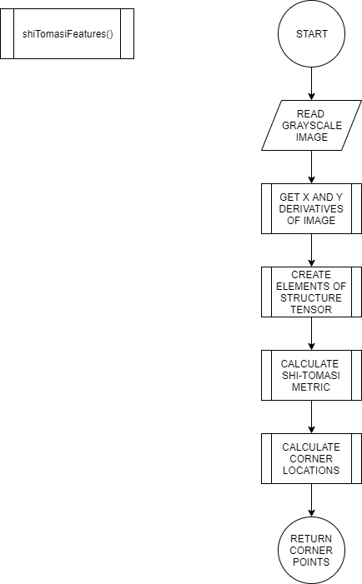
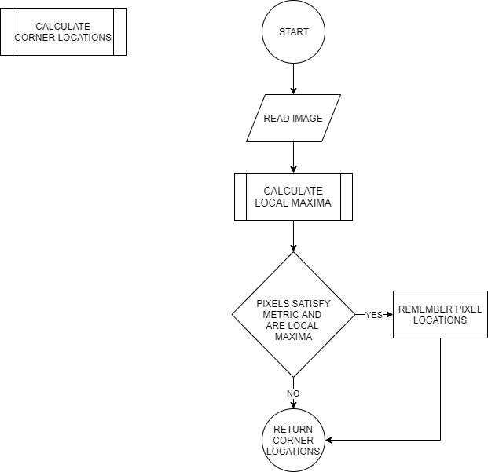
Implementation

Slide 4
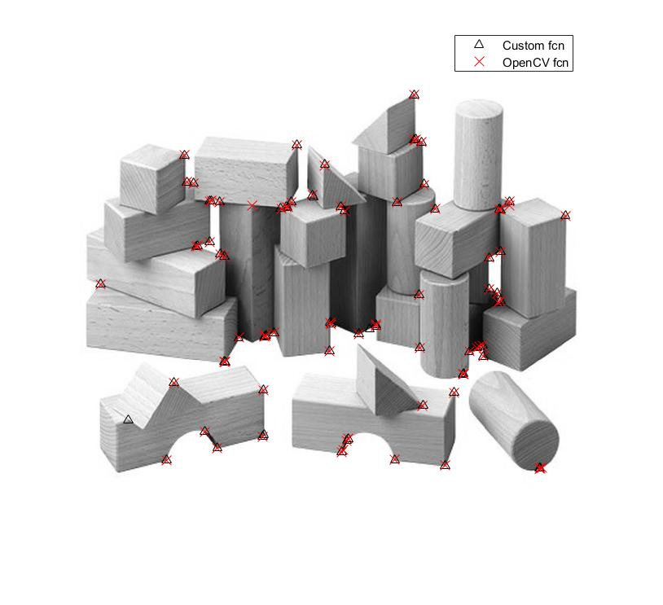
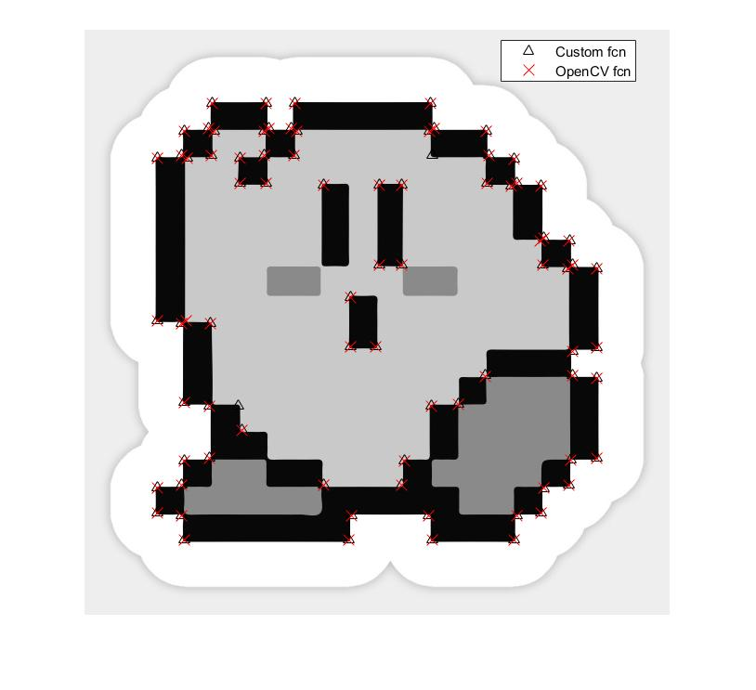
Experiments

Slide 5
Evaluation
Image | stavebnica.jpg | checkbox.jpg | dolphin_mesh.png | kirby.jpg
Amount of identical corners | 55 | 45 | 58 | 74
Percentage of identical corners | 69.6% | 57% | 73.4% | 93.7%
*100% is 79 corner points
Average amount of identical corners: 58
Average percentage of identical corners: 73.4%

Slide 6

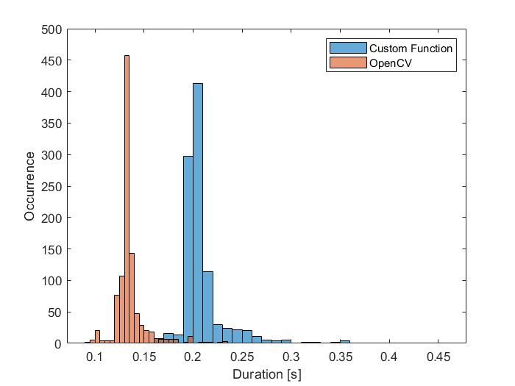
Evaluation
Average function call duration:
Custom Function: 0.20993s
OpenCV Function: 0.13657s

Slide 7
Thank you

